Slide 1

Respiratory Disaster Go – Kit
Provided by No Person Left Behind
501©3 May 2020

Slide 2
What is a disaster and what do you need to do for your Respiratory Needs?
A Disaster is anything is either man made or natural that you will need to be instructed to evacuate to a safe location or to shelter in place.
You will need to have a Respiratory Disaster Evacuation Go-Kit ready to go prior to a disaster.
This way you do not need to look for everything you need at the last minute.
You will need to have enough respiratory supplies for you to use in case a backup item is needed.
1 Gal of distilled water in leak proof container as needed.

Slide 3
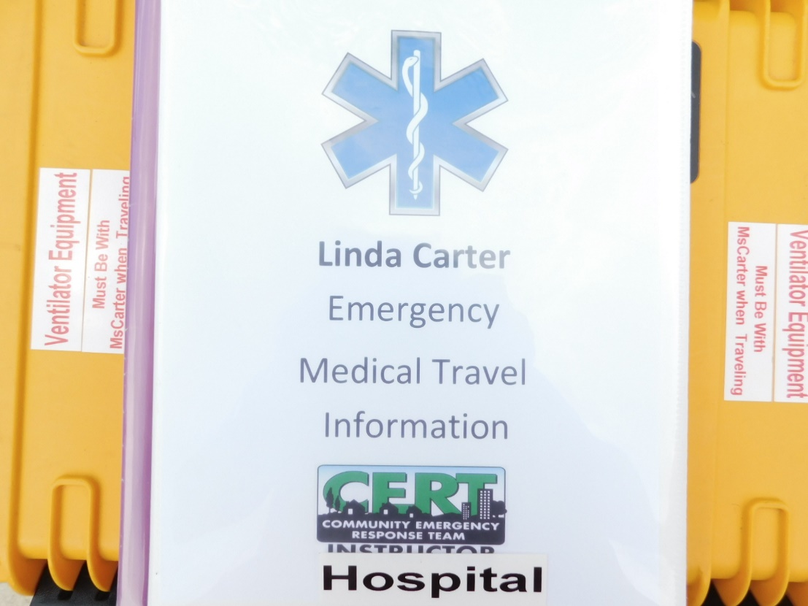
Emergency Medical Travel Information

Slide 4
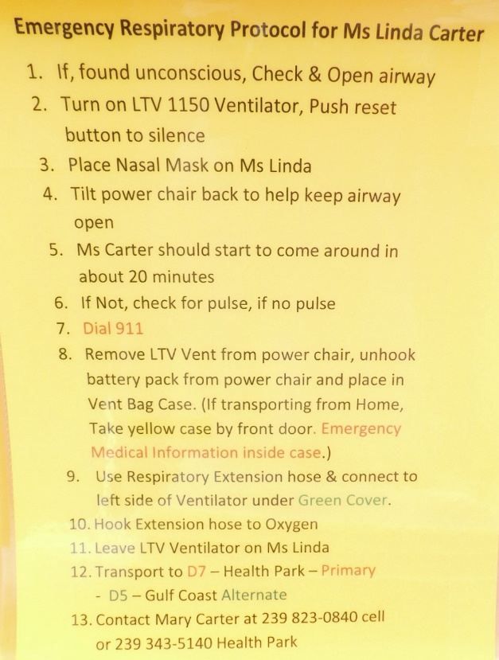
Emergency Respiratory Protocol

Slide 5
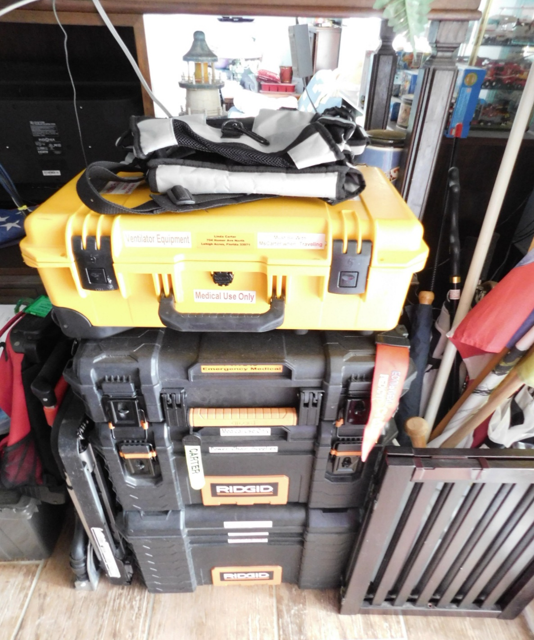
Respiratory Go-Kit Stored by
Front Door

Slide 6
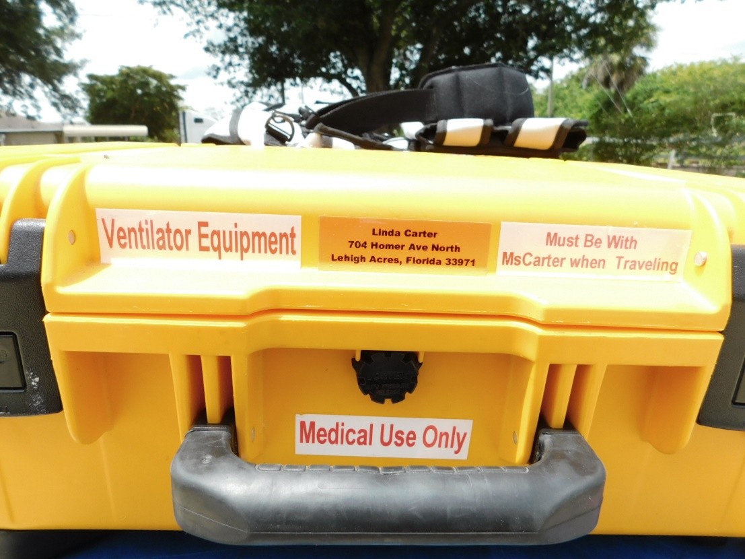
Respiratory Go-Kit Labeled

Slide 7
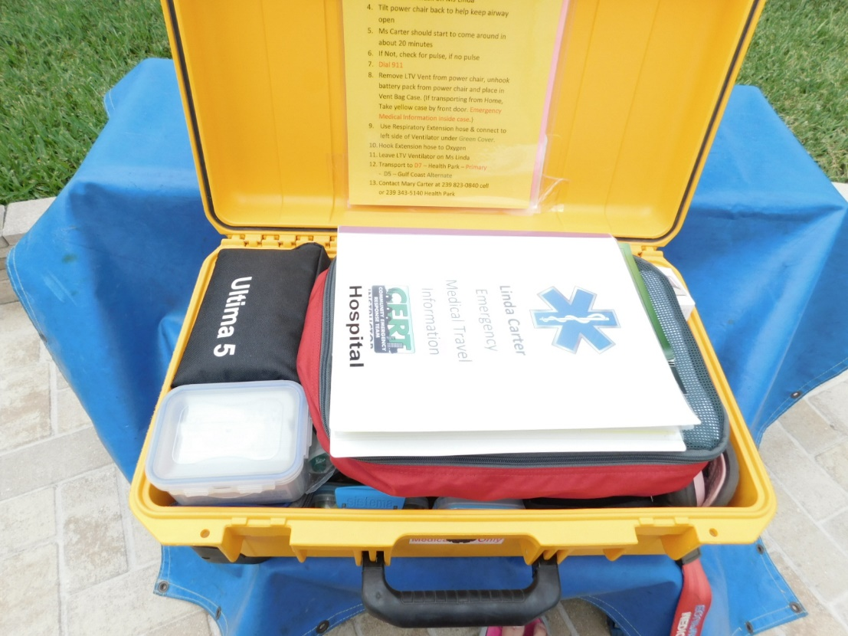
Respiratory Go-kit opened

Slide 8
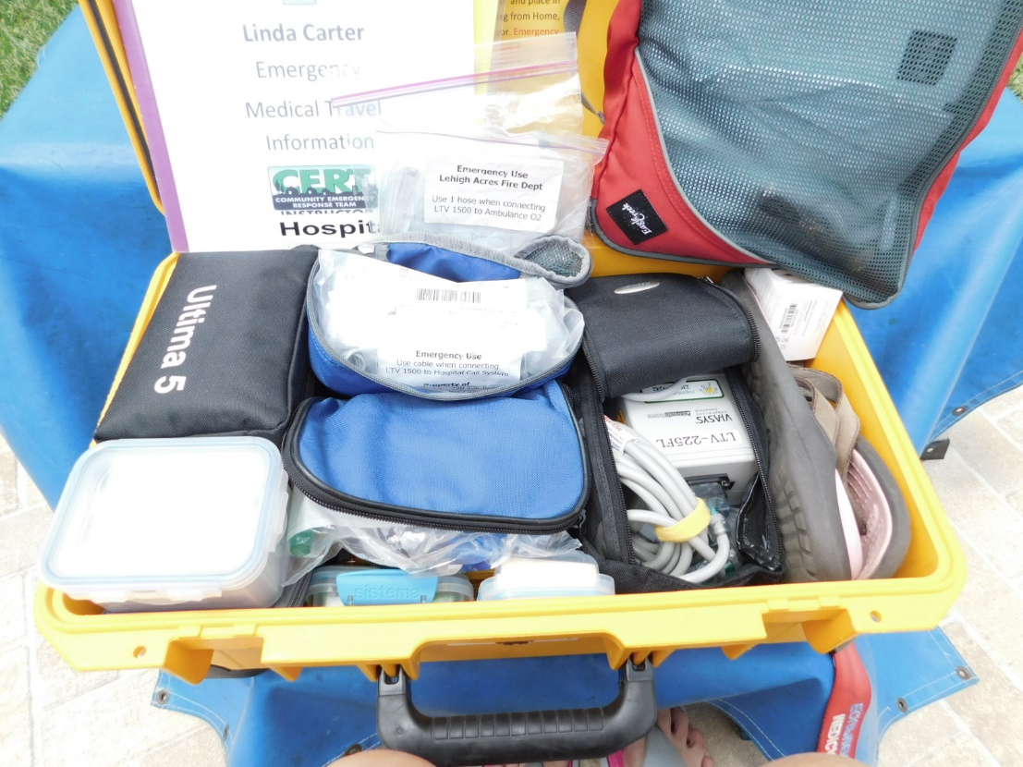
Respiratory Go-kit items

Slide 9
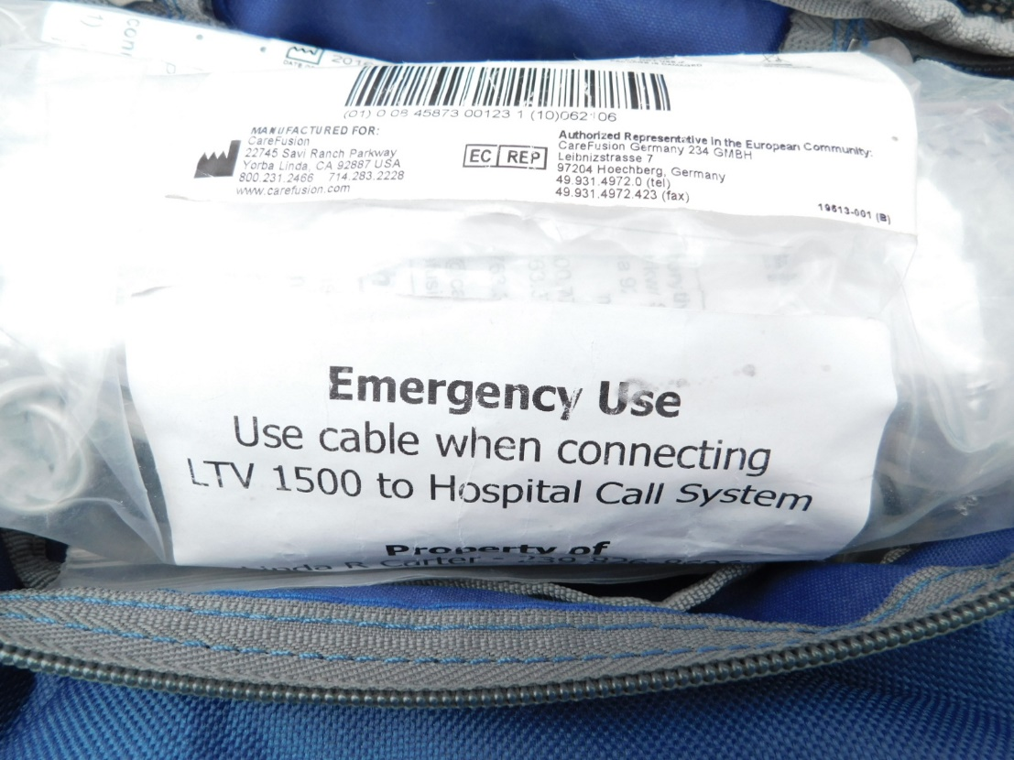
LTV 1150-1500 Hospital call system Cable

Slide 10
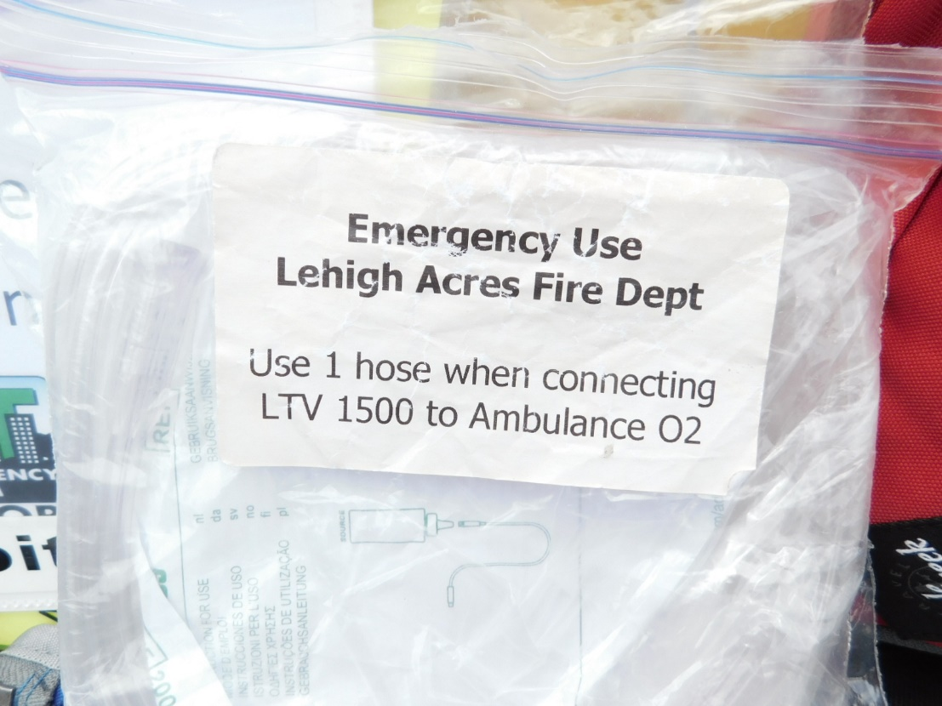
LTV 1150-1500 Connection hose

Slide 11
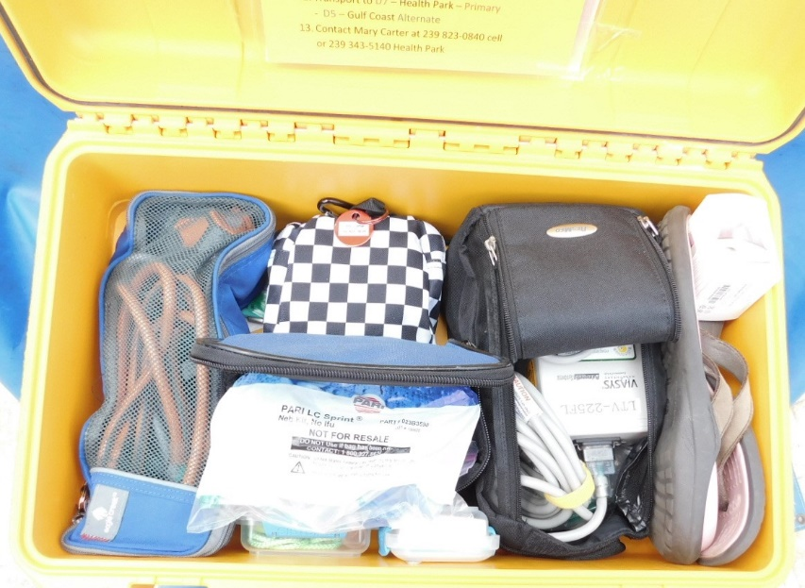
Respiratory Go-kit items

Slide 12
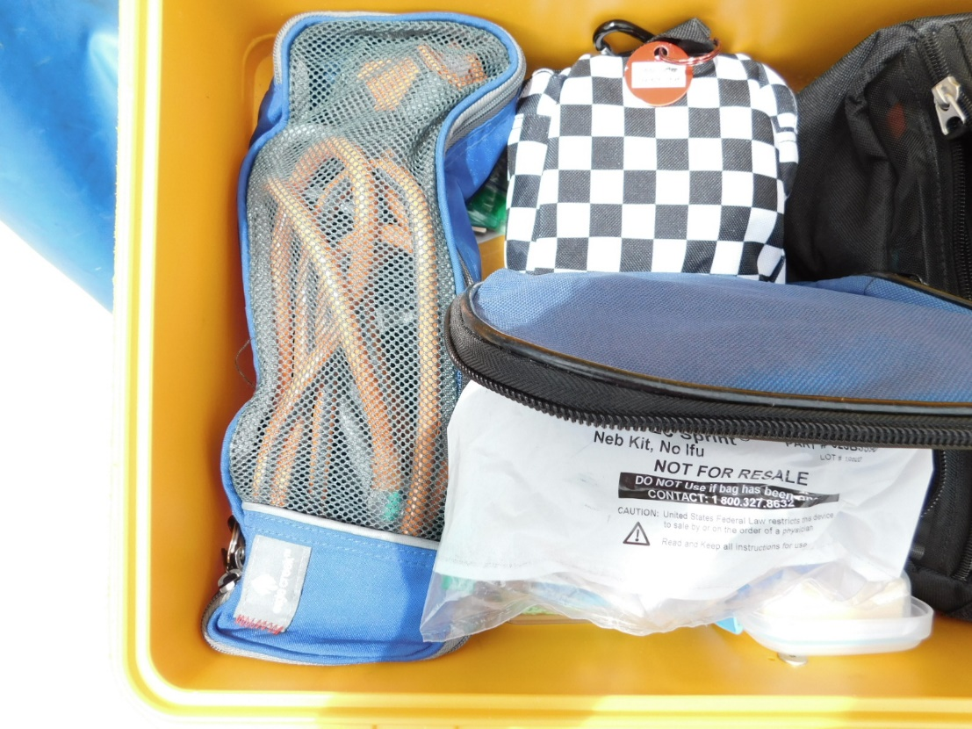
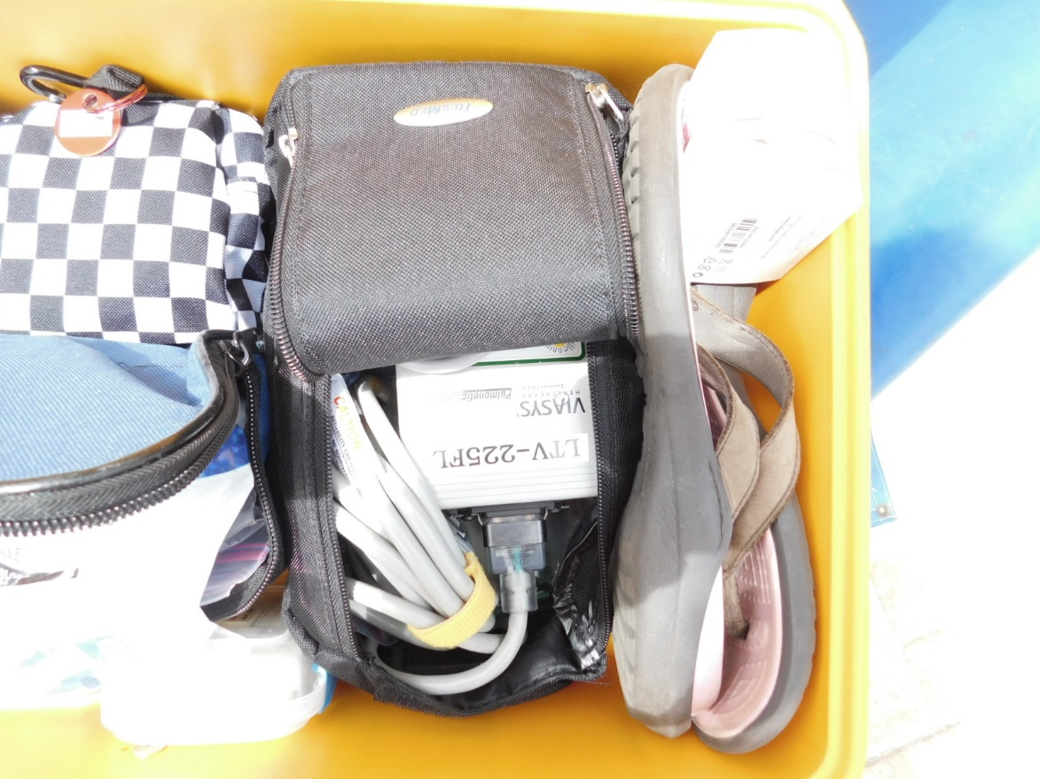
Respiratory Go-kit items Detailed

Slide 13
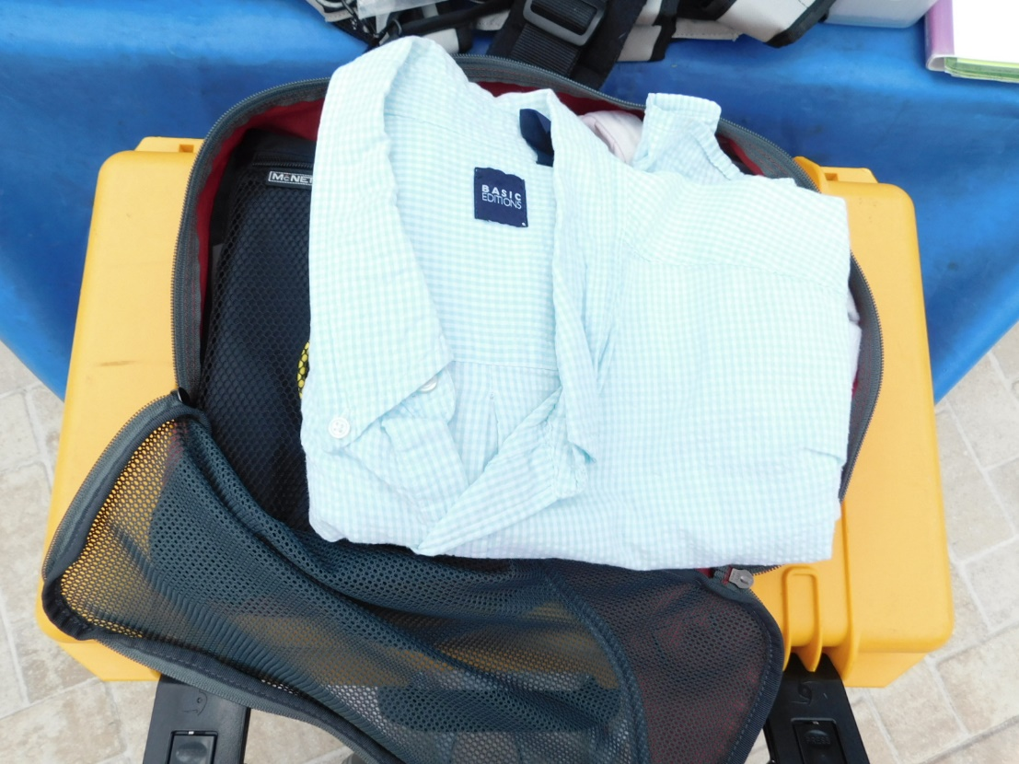
Respiratory Go-kit Extra Clothes & personal items

Slide 14
No Person Left Behind
Linda Carter
Executive Director
Linda.Carter@NoPersonLeftBehind.org
www.nopersonleftbehind.org
Videography Services Provided and
Video was created by Allison Carter
501©3 created Nov 20, 2008
Video made in May 2020

